Slide 1
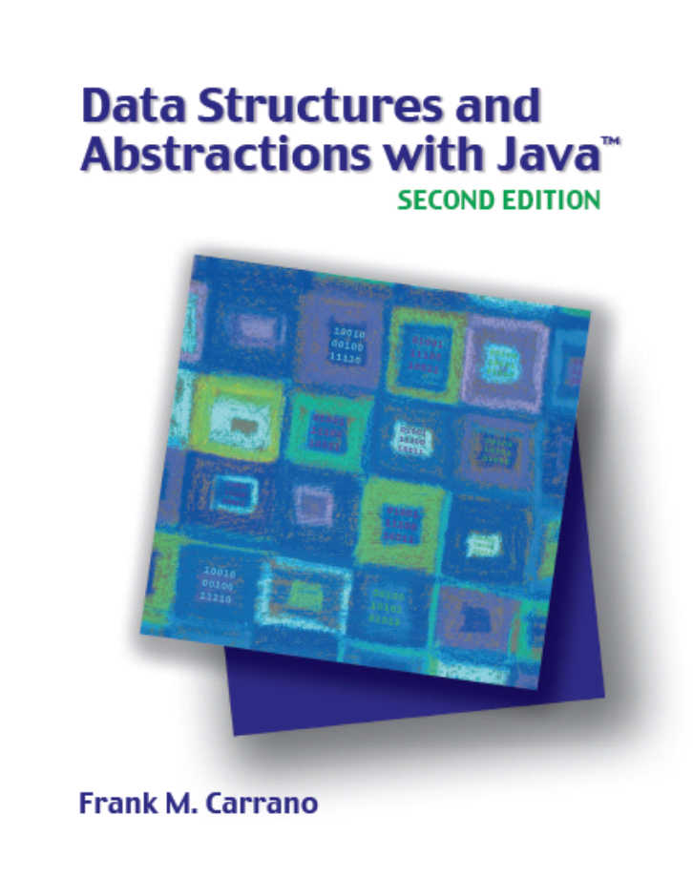

An Introduction to Sorting
Chapter 11
Slides by Steve Armstrong
LeTourneau University
Longview, TX
© 2007, Prentice Hall

Slide 2
Chapter Contents
Organizing Java Methods that Sort an Array
Selection Sort
  Iterative Selection Sort
  Recursive Selection Sort
  The Efficiency of Selection Sort
Insertion Sort
  Iterative Insertion Sort
  Recursive Insertion Sort
  The Efficiency of Insertion Sort
  Insertion Sort of a Chain of Linked Nodes

Slide 3
Chapter Contents
Shell Sort
  The Java Code
  The Efficiency of Shell Sort
Comparing the Algorithms

Slide 4
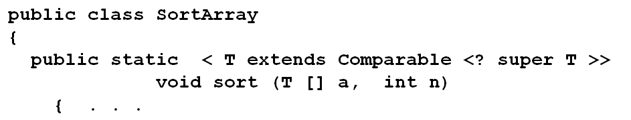
Organizing Java Methods that Sort an Array
Consider a class of static sort methods
Thus able to compare elements in an inheritance hierarchy

Slide 5
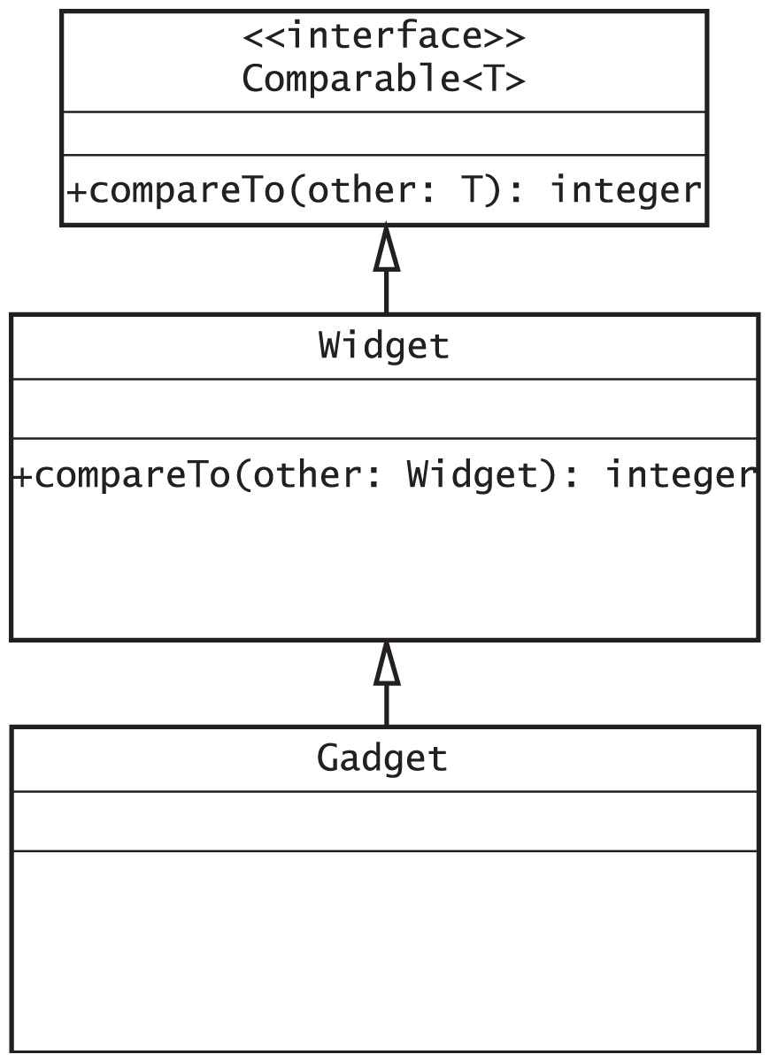
Organizing Java Methods that Sort an Array
Fig. 11-1 The class Gadget is derived from the class Widget, which implements the interface Comparable

Slide 6
Selection Sort
Task: rearrange books on shelf by height
  Shortest book on the left
Approach:
  Look at books, select shortest book
  Swap with first book
  Look at remaining books, select shortest
  Swap with second book
  Repeat …

Slide 7
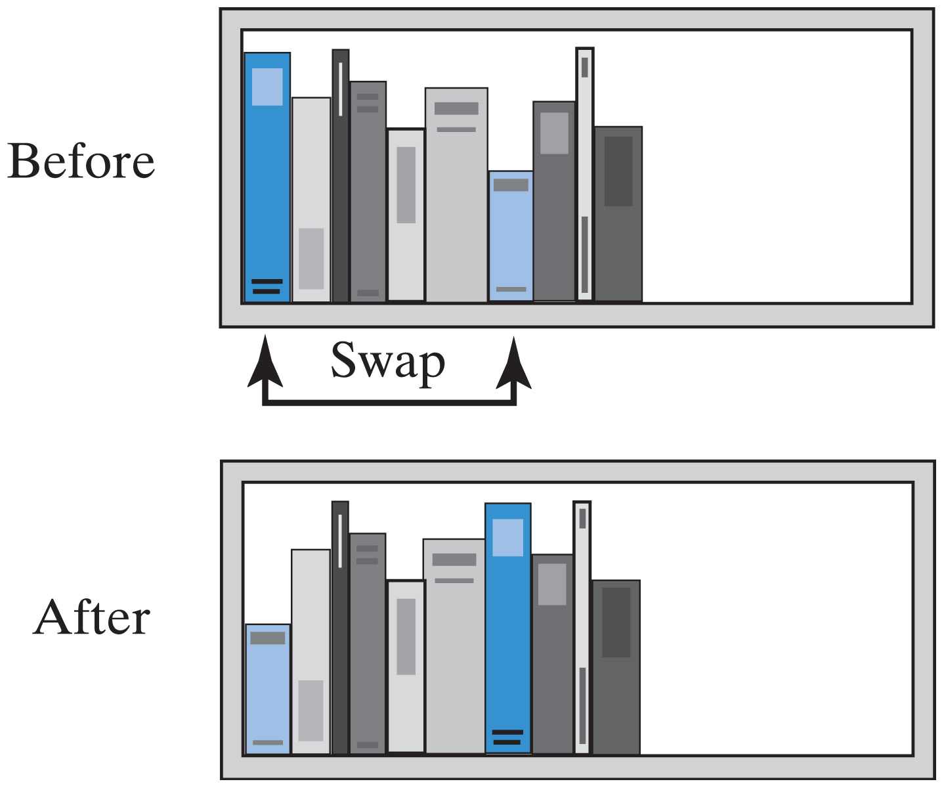
Selection Sort
Fig. 11-2 Before and after exchanging shortest book and the first book.

Slide 8
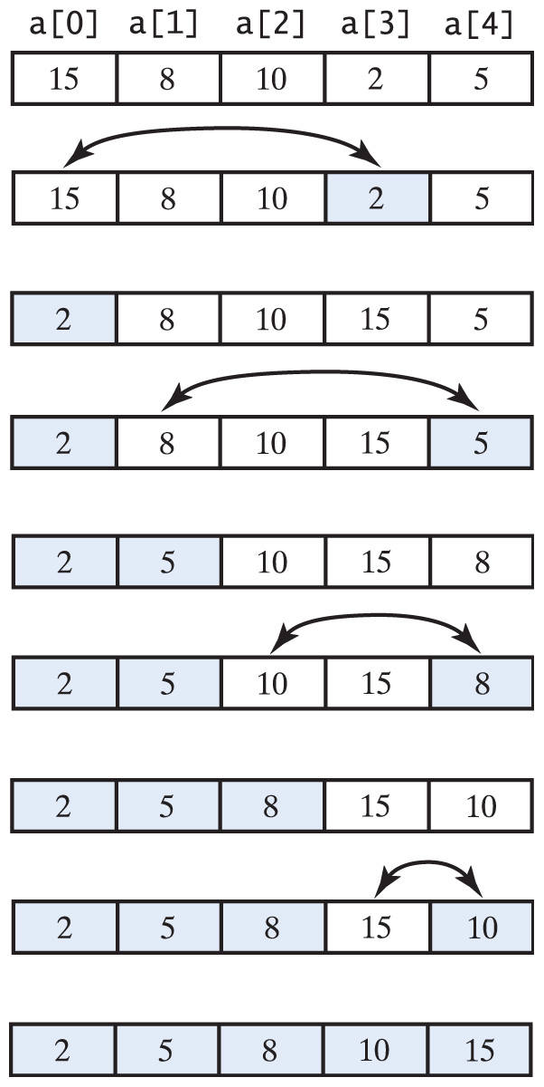
Selection Sort
Fig. 11-3 A selection sort of an array of integers into ascending order.

Slide 9
Iterative Selection Sort
View iterative algorithm for selection sort
View class for sorting an array using selection sort
  Search for index of smallest element
  Swap values in array elements
  Puts smallest at top of current sub array

Slide 10
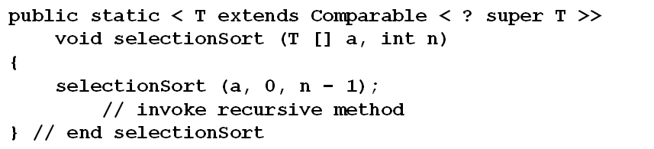
Recursive Selection Sort
View recursive algorithm for selection sort
Java implementation of recursive selection sort
  Consider giving parameters for the array, a beginning and ending index for flexibility

Slide 11
The Efficiency of Selection Sort
Iterative method for loop executes n – 1 times
  For each of n – 1 calls, inner loop executes
  n – 2 times
  (n – 1) + (n – 2) + …+ 1 = n(n – 1)/2 = O(n²)
Recursive selection sort performs same operations
  Also O(n²)

Slide 12
Insertion Sort
If first two books are out of order
  Remove second book
  Slide first book to right
  Insert removed book into first slot
Then look at third book, if it is out of order
  Remove that book
  Slide 2nd book to right
  Insert removed book into 2nd slot
Recheck first two books again
  Etc.

Slide 13
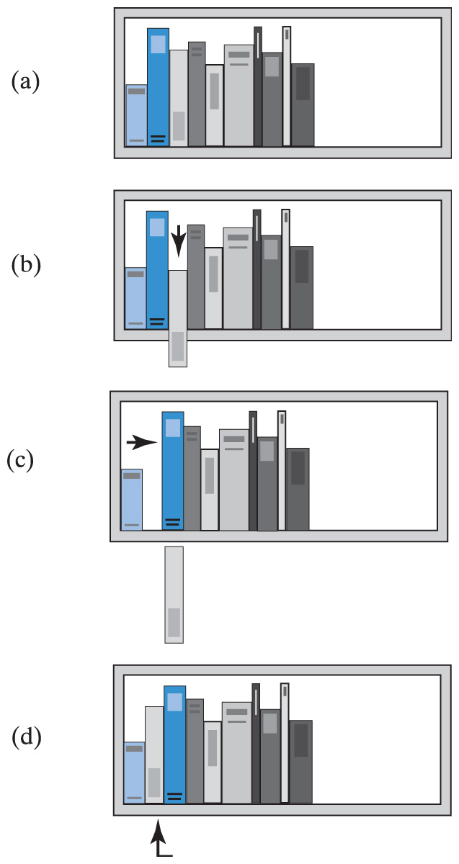
Insertion Sort
Fig. 11-4 The placement of the third book during an insertion sort.

Slide 14
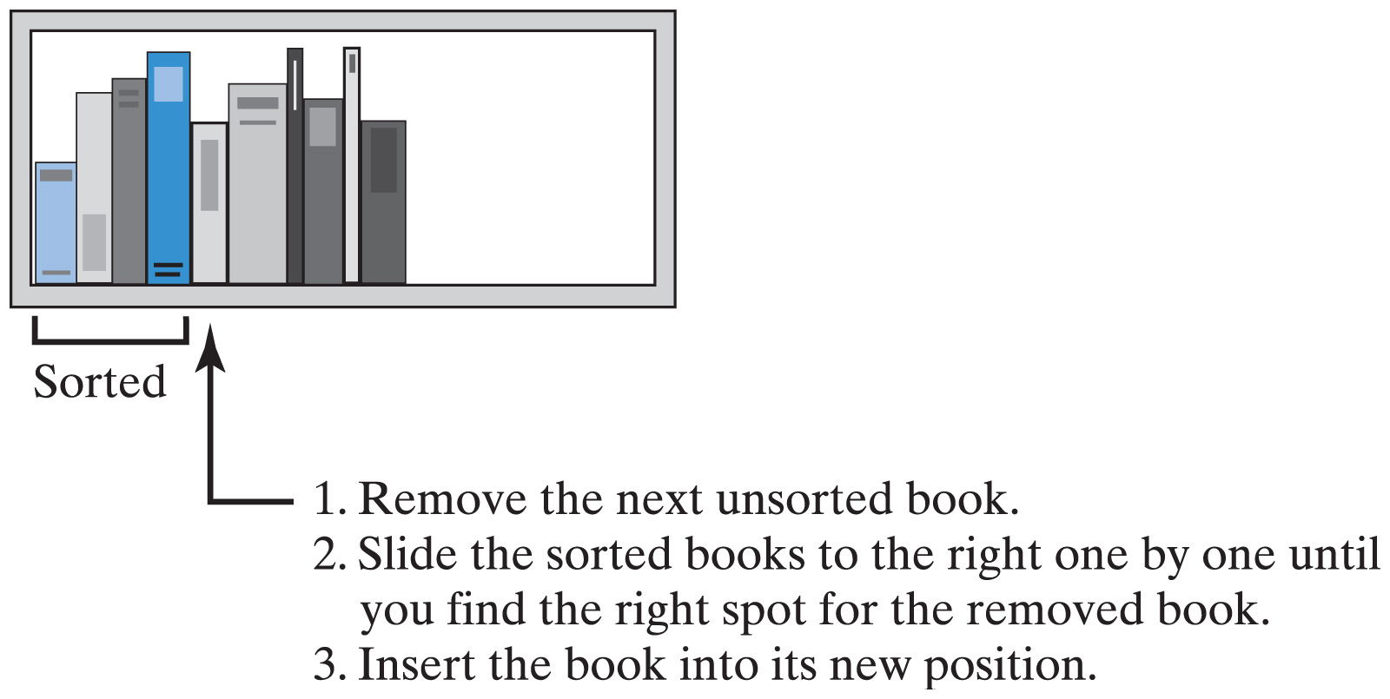
Insertion Sort
Fig. 11-5 An insertion sort of books

Slide 15
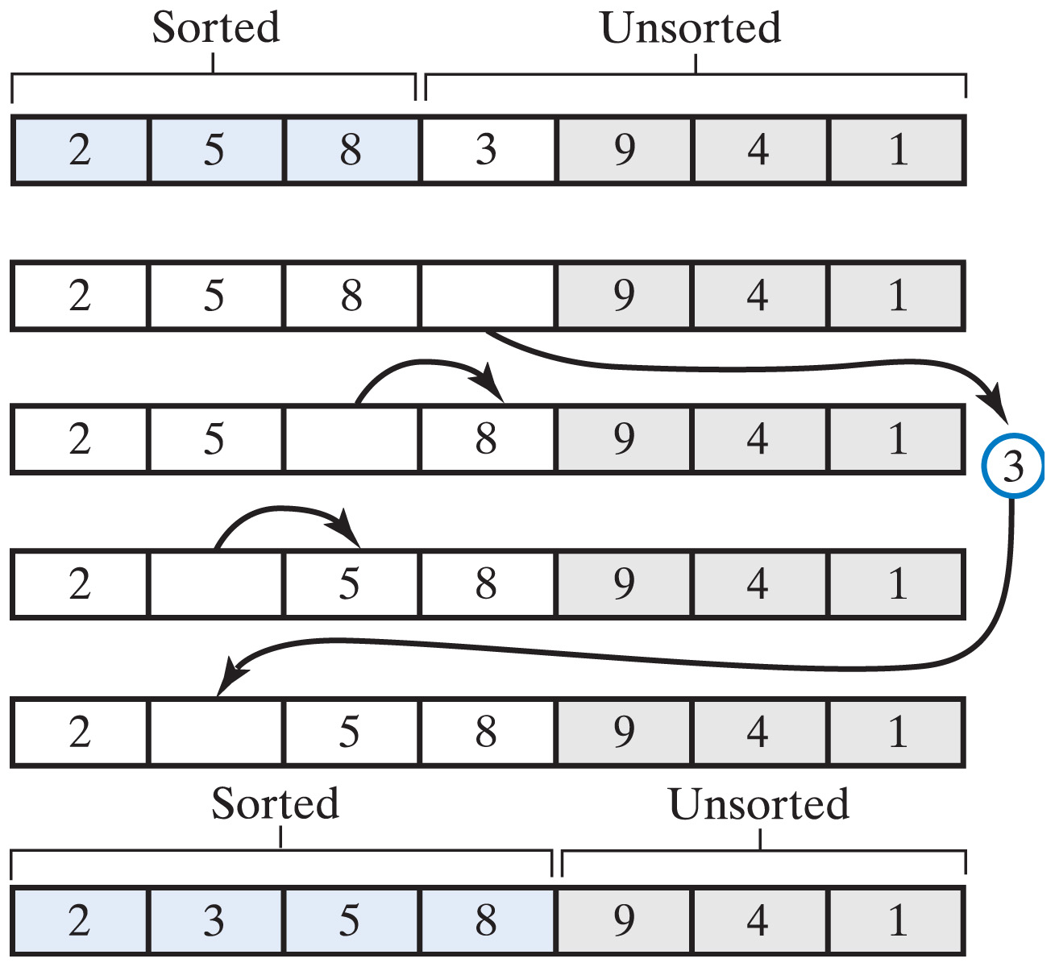
Iterative Insertion Sort
View iterative algorithm for insertion sort
  Note the algorithm for the insert of the item into the array
Fig. 11-6 An insertion sort inserts the next unsorted element into its proper location within the sorted portion of an array

Slide 16
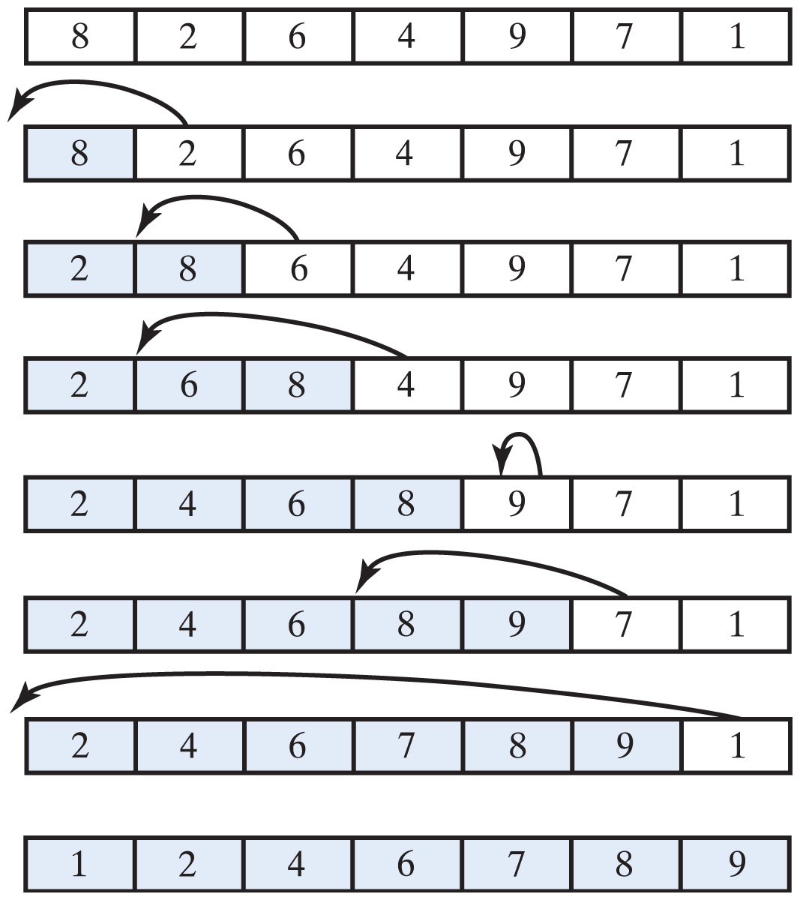
Iterative Insertion Sort
Fig. 11-7 An insertion sort of an array of integers into ascending order

Slide 17
Recursive Insertion Sort
View algorithm for recursive insertion sort
Java implementation of recursive insertion sort
  Can use an iterative insertInOrder (see algorithm)
  Can use a recursive version

Slide 18
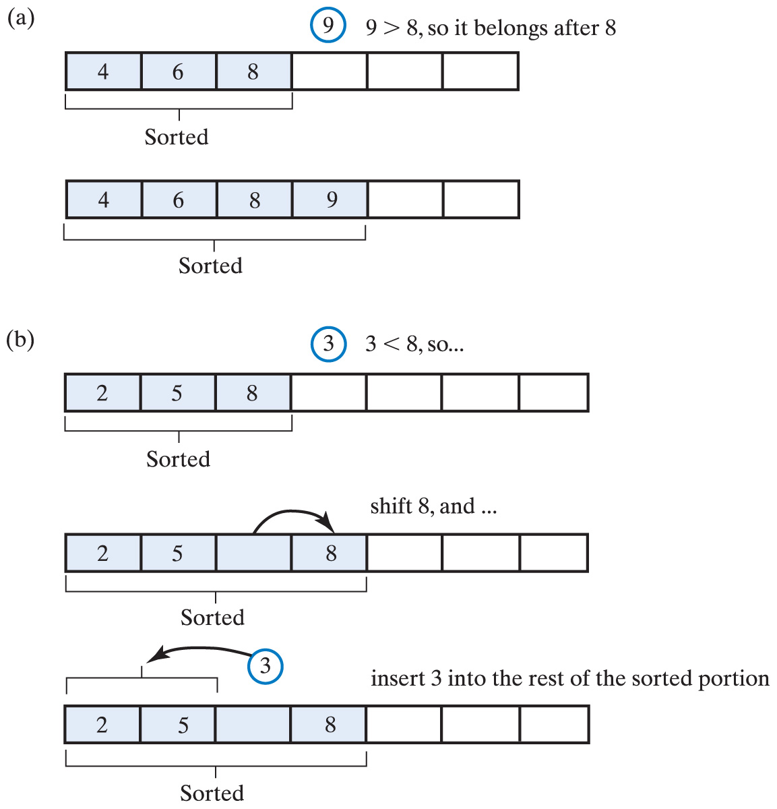
Recursive Insertion Sort
Fig. 11-8 Inserting the first unsorted element into the sorted portion of the array. (a) The element is ≥ last sorted element; (b) the element is < than last sorted element

Slide 19
Efficiency of Insertion Sort
Best time efficiency is O(n)
Worst time efficiency is O(n²)
If array is closer to sorted order
  Less work the insertion sort does
  More efficient the sort is
Insertion sort is acceptable for small array sizes

Slide 20
Insertion Sort of Chain of Linked Nodes
Fig. 11-9 A chain of integers sorted into ascending order.

Slide 21
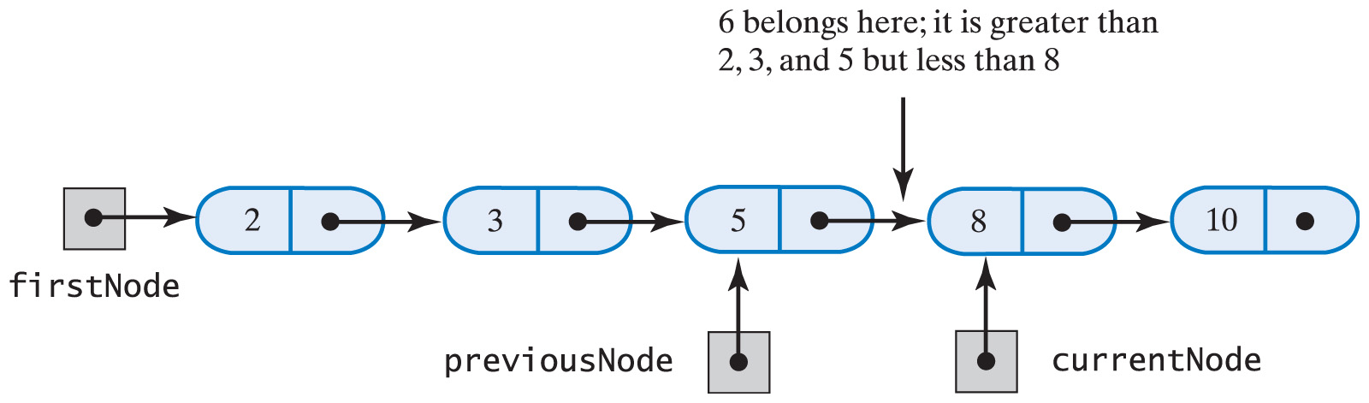
Insertion Sort of Chain of Linked Nodes
Fig. 11-10 During the traversal of a chain to locate the insertion point, save a reference to the node before the current one.

Slide 22
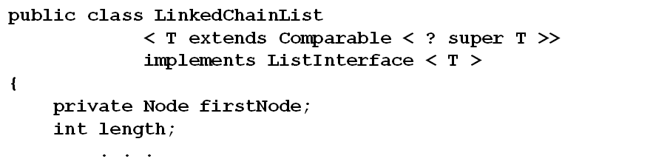
Insertion Sort of Chain of Linked Nodes
Consider adding a sort method to class LinkedChainList which uses ADT list
  Must implement Comparable
View code for sorting and inserting

Slide 23
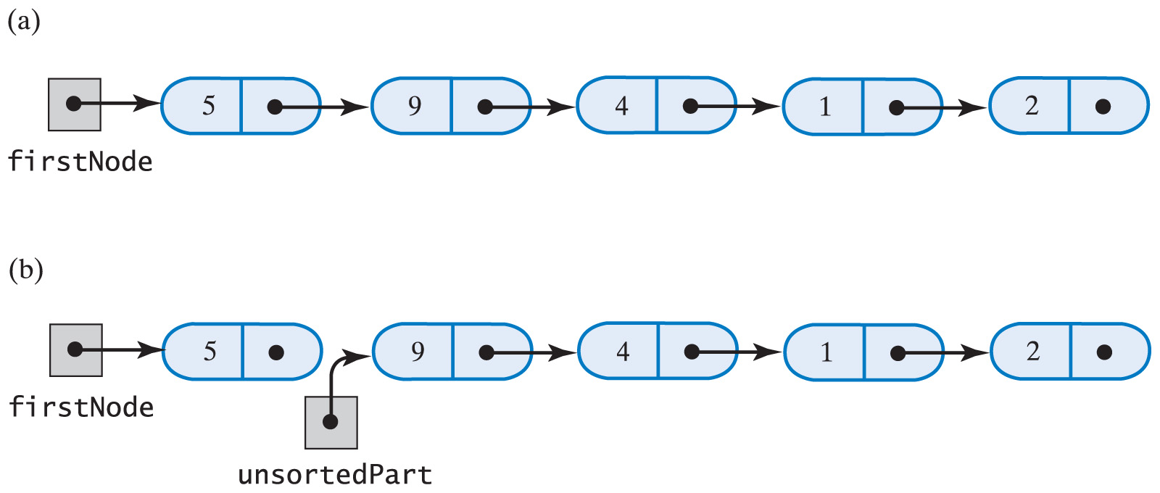
Insertion Sort of Chain of Linked Nodes
Efficiency of insertion sort of a chain is O(n²)
Fig. 11-11 Breaking a chain of nodes into two pieces as the first step in an insertion sort:
(a) the original chain; (b) the two pieces

Slide 24
Shell Sort
A variation of the insertion sort
  But faster than O(n²)
Done by sorting subarrays of equally spaced indices
Instead of moving to an adjacent location an element moves several locations away
  Results in an almost sorted array
  This array sorted efficiently with ordinary insertion sort

Slide 25
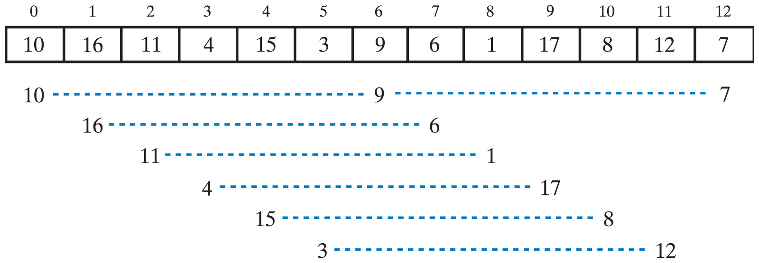
Shell Sort
Fig. 11-12 An array and the subarrays formed by grouping elements whose indices are 6 apart.

Slide 26
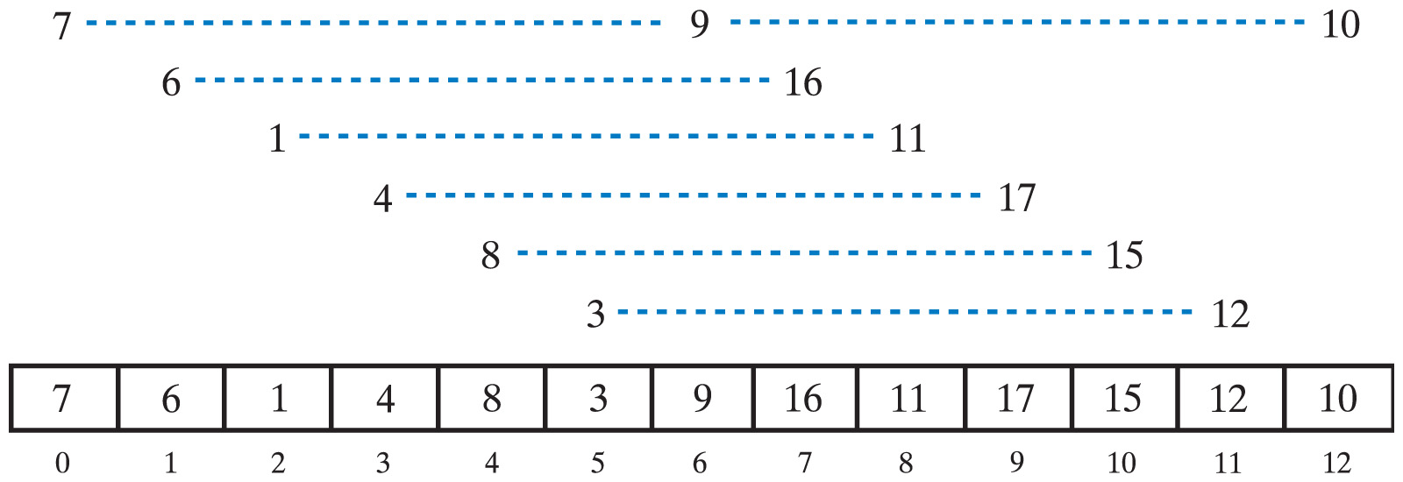
Shell Sort
Fig. 11-13 The subarrays of Fig. 11-12 after they are sorted, and the array that contains them.

Slide 27
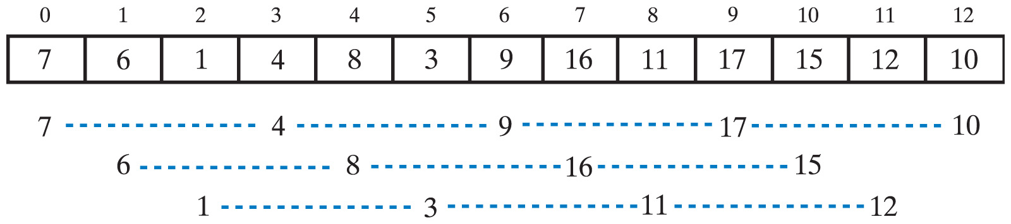
Shell Sort
Fig. 11-14 The subarrays of the array in Fig. 11-13 formed by grouping elements whose indices are 3 apart

Slide 28
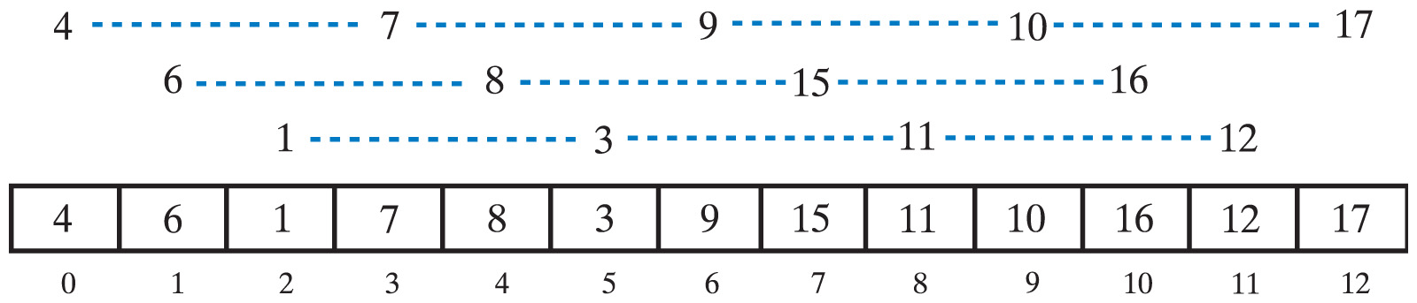
Shell Sort
Fig. 11-15 The subarrays of Fig. 11-14 after they are sorted, and the array that contains them.
View source code for
incrementalInsertionSort and
shellSort

Slide 29
Efficiency of Shell Sort
Efficiency is O(n²) for worst case
If n is a power of 2
  Average-case behavior is O(n^{1.5})
Any time the variable space (see source code) is even, add 1
  This also results in O(n^{1.5})

Slide 30
Comparing the Algorithms
Best Average Worst
Case Case Case
Selection sort O(n²) O(n²) O(n²)
Insertion sort O(n) O(n²) O(n²)
Shell sort O(n) O(n^{1.5}) O(n^{1.5})
Fig. 11-16 The time efficiencies of three sorting algorithms, expressed in Big Oh notation.

